Slide 1


Assembly Language for x86 Processors 7th Edition
Kip R. Irvine
Lecture 6: Conditional Processing - 1
(c) Pearson Education, 2015. All rights reserved. You may modify and copy this slide show for your personal use, or for use in the classroom, as long as this copyright statement, the author's name, and the title are not changed.
Last update: 18/05/2020

Slide 2
Lecture Overview
Boolean and Comparison Instructions
Conditional Jumps
Conditional Loop Instructions
Irvine, Kip R. Assembly Language for x86 Processors 7/e, 2015.

Slide 3
Boolean and Comparison Instructions
CPU Status Flags
AND Instruction
OR Instruction
XOR Instruction
NOT Instruction
Applications
TEST Instruction
CMP Instruction
Irvine, Kip R. Assembly Language for x86 Processors 7/e, 2015.

Slide 4
Status Flags - Review
The Zero flag is set when the result of an operation equals zero.
The Carry flag is set when an instruction generates a result that is too large (or too small) for the destination operand.
The Sign flag is set if the destination operand is negative, and it is clear if the destination operand is positive.
The Overflow flag is set when an instruction generates an invalid signed result.
Irvine, Kip R. Assembly Language for x86 Processors 7/e, 2015.

Slide 5


AND Instruction
Performs a Boolean AND operation between each pair of matching bits in two operands
Syntax:
    AND destination, source
  (same operand types as MOV)
AND
Irvine, Kip R. Assembly Language for x86 Processors 7/e, 2015.

Slide 6


OR Instruction
Performs a Boolean OR operation between each pair of matching bits in two operands
Syntax:
    OR destination, source
OR
Irvine, Kip R. Assembly Language for x86 Processors 7/e, 2015.

Slide 7

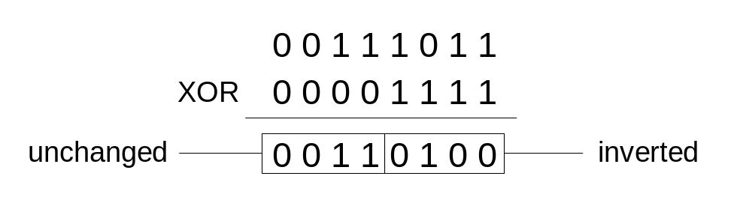
XOR Instruction
Performs a Boolean exclusive-OR operation between each pair of matching bits in two operands
Syntax:
    XOR destination, source
XOR
XOR is a useful way to toggle (invert) the bits in an operand.
Irvine, Kip R. Assembly Language for x86 Processors 7/e, 2015.

Slide 8

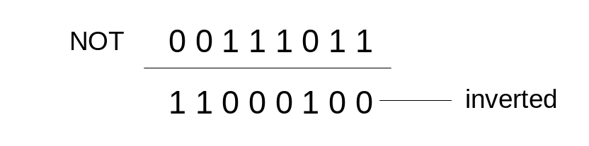
NOT Instruction
Performs a Boolean NOT operation on a single destination operand
Syntax:
    NOT destination
NOT
Irvine, Kip R. Assembly Language for x86 Processors 7/e, 2015.

Slide 9
Applications (1 of 4)
Task: Convert the character in AL to upper case.
Solution: Use the AND instruction to clear bit 5.
mov al,'a' ; AL = 01100001b
and al,11011111b ; AL = 01000001b
Irvine, Kip R. Assembly Language for x86 Processors 7/e, 2015.

Slide 10
Applications (2 of 4)
Task: Convert a binary decimal byte into its equivalent ASCII decimal digit.
Solution: Use the OR instruction to set bits 4 and 5.
mov al,6 ; AL = 00000110b
or al,00110000b ; AL = 00110110b
The ASCII digit '6' = 00110110b
Irvine, Kip R. Assembly Language for x86 Processors 7/e, 2015.

Slide 11
Applications (3 of 4)
Task: Jump to a label if an integer is even.
Solution: AND the lowest bit with a 1. If the result is Zero, the number was even.
mov ax,wordVal
and ax,1 ; low bit set?
jz EvenValue ; jump if Zero flag set
JZ (jump if Zero) is covered later
Irvine, Kip R. Assembly Language for x86 Processors 7/e, 2015.

Slide 12
Applications (4 of 4)
Task: Jump to a label if the value in AL is not zero.
Solution: OR the byte with itself, then use the JNZ (jump if not zero) instruction.
or al,al
jnz IsNotZero ; jump if not zero
ORing any number with itself does not change its value.
Irvine, Kip R. Assembly Language for x86 Processors 7/e, 2015.

Slide 13
TEST Instruction
Performs a nondestructive AND operation between each pair of matching bits in two operands
No operands are modified, but the Zero flag is affected.
Example: jump to a label if either bit 0 or bit 1 in AL is set.
test al,00000011b
jnz ValueFound
Example: jump to a label if neither bit 0 nor bit 1 in AL is set.
0 0 1 0 0 1 0 1 <- input value
0 0 0 0 1 0 0 1 <- test value
0 0 0 0 0 0 0 1 <- result: ZF = 0
0 0 1 0 0 1 0 0 <- input value
0 0 0 0 1 0 0 1 <- test value
0 0 0 0 0 0 0 0 <- result: ZF = 1
test al,00000011b
jz ValueNotFound
Irvine, Kip R. Assembly Language for x86 Processors 7/e, 2015.

Slide 14
CMP Instruction (1 of 3)
Compares the destination operand to the source operand
  Nondestructive subtraction of source from destination (destination operand is not changed)
Syntax: CMP destination, source
Example: destination == source
mov al,5
cmp al,5 ; Zero flag set
Example: destination < source
mov al,4
cmp al,5 ; Carry flag set
Irvine, Kip R. Assembly Language for x86 Processors 7/e, 2015.

Slide 15
CMP Instruction (2 of 3)
Example: destination > source
mov al,6
cmp al,5 ; ZF = 0, CF = 0
(both the Zero and Carry flags are clear)
Irvine, Kip R. Assembly Language for x86 Processors 7/e, 2015.

Slide 16
CMP Instruction (3 of 3)
The comparisons shown here are performed with signed integers.
Example: destination > source
mov al,5
cmp al,-2 ; Sign flag == Overflow flag
Example: destination < source
mov al,-1
cmp al,5 ; Sign flag != Overflow flag
Irvine, Kip R. Assembly Language for x86 Processors 7/e, 2015.

Slide 17
What's Next
Boolean and Comparison Instructions
Conditional Jumps
Conditional Loop Instructions
Irvine, Kip R. Assembly Language for x86 Processors 7/e, 2015.

Slide 18
Conditional Jumps
Jumps Based On . . .
  Specific flags
  Equality
  Unsigned comparisons
  Signed Comparisons
Applications
Encrypting a String
Irvine, Kip R. Assembly Language for x86 Processors 7/e, 2015.

Slide 19
Jcond Instruction
A conditional jump instruction branches to a label when specific register or flag conditions are met
Irvine, Kip R. Assembly Language for x86 Processors 7/e, 2015.

Slide 20
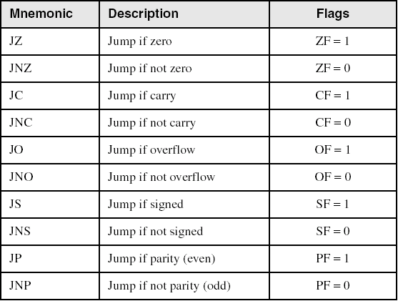
Jumps Based on Specific Flags
Irvine, Kip R. Assembly Language for x86 Processors 7/e, 2015.

Slide 21
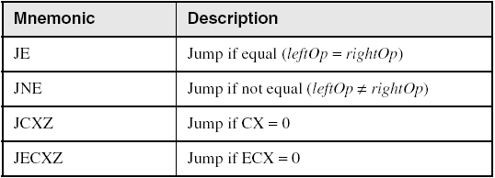
Jumps Based on Equality
Irvine, Kip R. Assembly Language for x86 Processors 7/e, 2015.

Slide 22
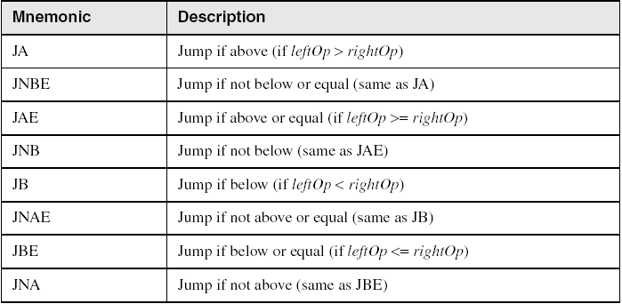
Jumps Based on Unsigned Comparisons
Irvine, Kip R. Assembly Language for x86 Processors 7/e, 2015.

Slide 23
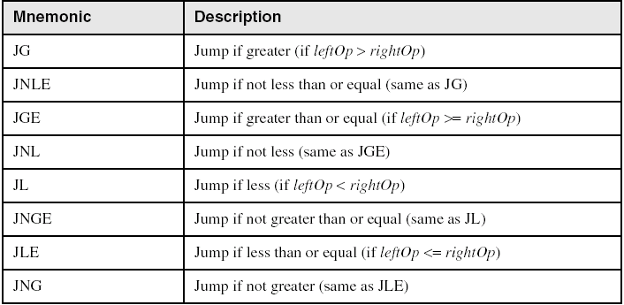
Jumps Based on Signed Comparisons
Irvine, Kip R. Assembly Language for x86 Processors 7/e, 2015.

Slide 24
Applications (1 of 3)
Task: Jump to a label if unsigned EAX is greater than EBX
Solution: Use CMP, followed by JA
cmp eax,ebx
ja Larger
Task: Jump to a label if signed EAX is greater than EBX
Solution: Use CMP, followed by JG
cmp eax,ebx
jg Greater
Irvine, Kip R. Assembly Language for x86 Processors 7/e, 2015.

Slide 25
Applications (2 of 3)
Jump to label L1 if unsigned EAX is less than or equal to Val1
cmp eax,Val1
jbe L1 ; below or equal
Jump to label L1 if signed EAX is less than or equal to Val1
cmp eax,Val1
jle L1
Irvine, Kip R. Assembly Language for x86 Processors 7/e, 2015.

Slide 26
Applications (3 of 3)
Compare unsigned AX to BX, and copy the larger of the two into a variable named Large
  mov Large,bx
  cmp ax,bx
  jna Next
  mov Large,ax
Next:
Compare signed AX to BX, and copy the smaller of the two into a variable named Small
  mov Small,ax
  cmp bx,ax
  jnl Next
  mov Small,bx
Next:
Irvine, Kip R. Assembly Language for x86 Processors 7/e, 2015.

Slide 27
Encrypting a String
The following loop uses the XOR instruction to transform every character in a string into a new value.
KEY = 239 ; can be any byte value
BUFMAX = 128
.data
buffer BYTE BUFMAX+1 DUP(0)
bufSize DWORD BUFMAX
.code
  mov ecx,bufSize ; loop counter
  mov esi,0 ; index 0 in buffer
L1:
  xor buffer[esi],KEY ; translate a byte
  inc esi ; point to next byte
  loop L1
Irvine, Kip R. Assembly Language for x86 Processors 7/e, 2015.

Slide 28
What's Next
Boolean and Comparison Instructions
Conditional Jumps
Conditional Loop Instructions
Irvine, Kip R. Assembly Language for x86 Processors 7/e, 2015.

Slide 29
Conditional Loop Instructions
LOOPZ and LOOPE
LOOPNZ and LOOPNE
Irvine, Kip R. Assembly Language for x86 Processors 7/e, 2015.

Slide 30
LOOPZ and LOOPE
Syntax:
  LOOPE destination
  LOOPZ destination
The LOOPZ (loop if zero) instruction works just like the LOOP instruction except that it has one additional condition: the Zero flag must be set in order for control to transfer to the destination label
The LOOPE (loop if equal) instruction is equivalent to LOOPZ, and they share the same opcode.
Irvine, Kip R. Assembly Language for x86 Processors 7/e, 2015.

Slide 31
LOOPZ and LOOPE (Cont)
Logic:
  ECX ← ECX – 1
  if ECX > 0 and ZF=1, jump to destination
Useful when scanning an array for the first element that does not match a given value.
Irvine, Kip R. Assembly Language for x86 Processors 7/e, 2015.

Slide 32
LOOPNZ and LOOPNE
LOOPNZ (LOOPNE) is a conditional loop instruction
Syntax:
LOOPNZ destination
LOOPNE destination
Logic:
  ECX ← ECX – 1;
  if ECX > 0 and ZF=0, jump to destination
Useful when scanning an array for the first element that matches a given value.
Irvine, Kip R. Assembly Language for x86 Processors 7/e, 2015.

Slide 33
Summary
Bitwise instructions (AND, OR, XOR, NOT, TEST)
  manipulate individual bits in operands
CMP – compares operands using implied subtraction
  sets condition flags
Conditional Jumps & Loops
  equality: JE, JNE
  flag values: JC, JZ, JNC, JP, ...
  signed: JG, JL, JNG, ...
  unsigned: JA, JB, JNA, ...
  LOOPZ, LOOPNZ, LOOPE, LOOPNE
Irvine, Kip R. Assembly Language for x86 Processors 7/e, 2015.

Slide 34

4C 6F 70 70 75 75 6E
Irvine, Kip R. Assembly Language for x86 Processors 7/e, 2015.

